Slide 1
Computer Organization & Assembly
Week 8
Memory-1
Dr. Abdul Hameed Pitafi

Slide 2
Memory
It is a physical device use for storage purpose.
Device to store the contents of computer system.
In computer, we do not use a single memory. We use memory hierarchy.

Slide 3
Memory Hierarchy
Design constraints on a computer’s memory can be summed up by three questions:
How much, how fast, how expensive
There is a trade-off among capacity, access time, and cost
Faster access time, greater cost per bit
Greater capacity, smaller cost per bit
Greater capacity, slower access time
The way out of the memory problem is not to rely on a single memory component or technology, but to employ a “memory hierarchy”
Notes:
The design constraints on a computer’s memory can be summed up by three questions:
How much? How fast? How expensive?
The question of how much is somewhat open ended. If the capacity is there,
applications will likely be developed to use it. The question of how fast is, in a sense,
easier to answer. To achieve greatest performance, the memory must be able to
keep up with the processor. That is, as the processor is executing instructions, we
would not want it to have to pause waiting for instructions or operands. The final
question must also be considered. For a practical system, the cost of memory must
be reasonable in relationship to other components.
As might be expected, there is a trade-off among the three key characteristics
of memory: capacity, access time, and cost. A variety of technologies are used to
implement memory systems, and across this spectrum of technologies, the following
relationships hold:
• Faster access time, greater cost per bit
• Greater capacity, smaller cost per bit
• Greater capacity, slower access time
The dilemma facing the designer is clear. The designer would like to use memory
technologies that provide for large-capacity memory, both because the capacity
is needed and because the cost per bit is low. However, to meet performance
requirements, the designer needs to use expensive, relatively lower-capacity memories
with short access times.
The way out of this dilemma is not to rely on a single memory component or
technology, but to employ a memory hierarchy.

Slide 4
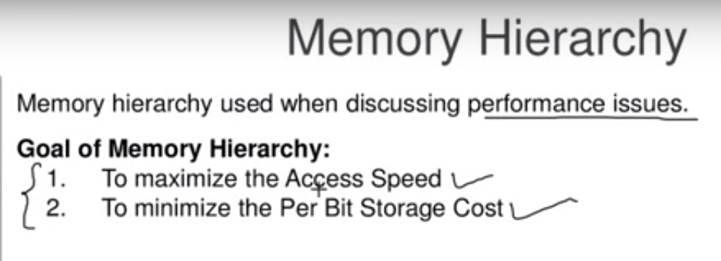

Slide 5
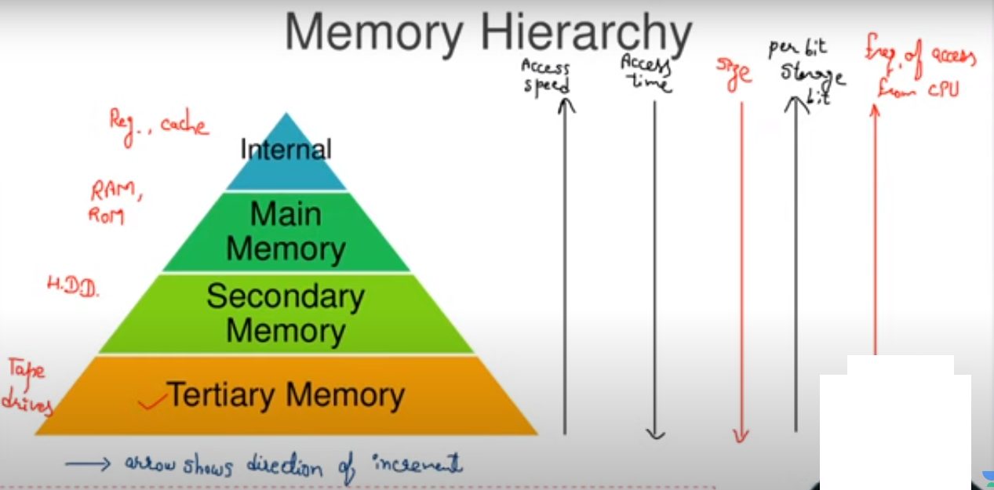

Slide 6
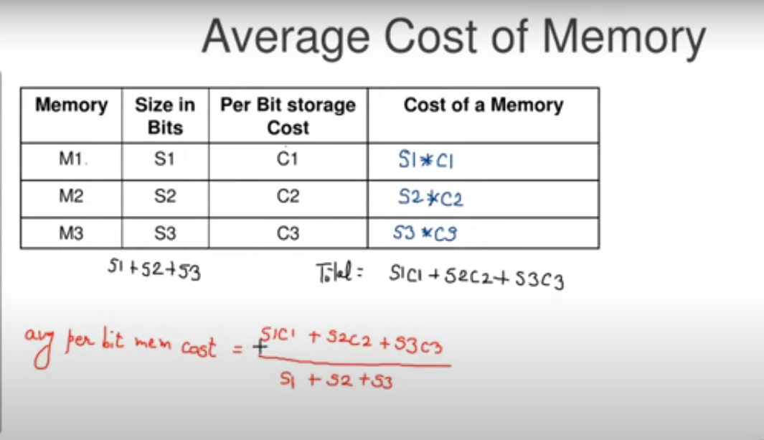
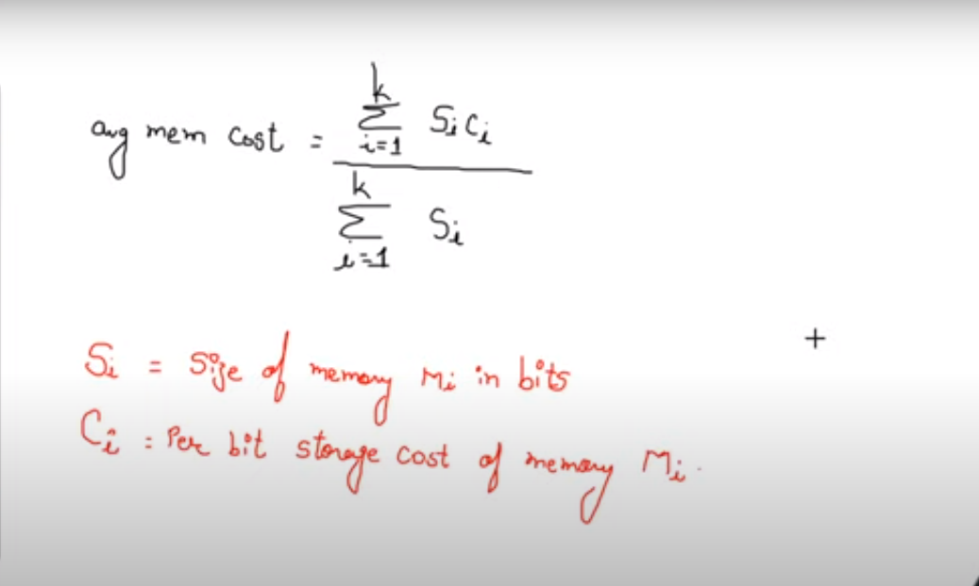

Slide 7
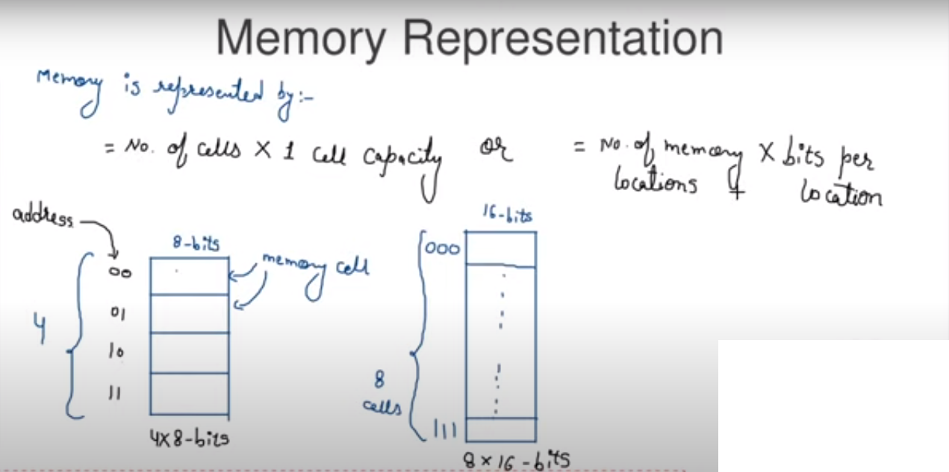

Slide 8
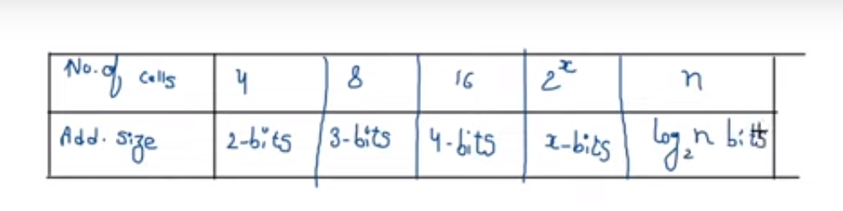

Slide 9
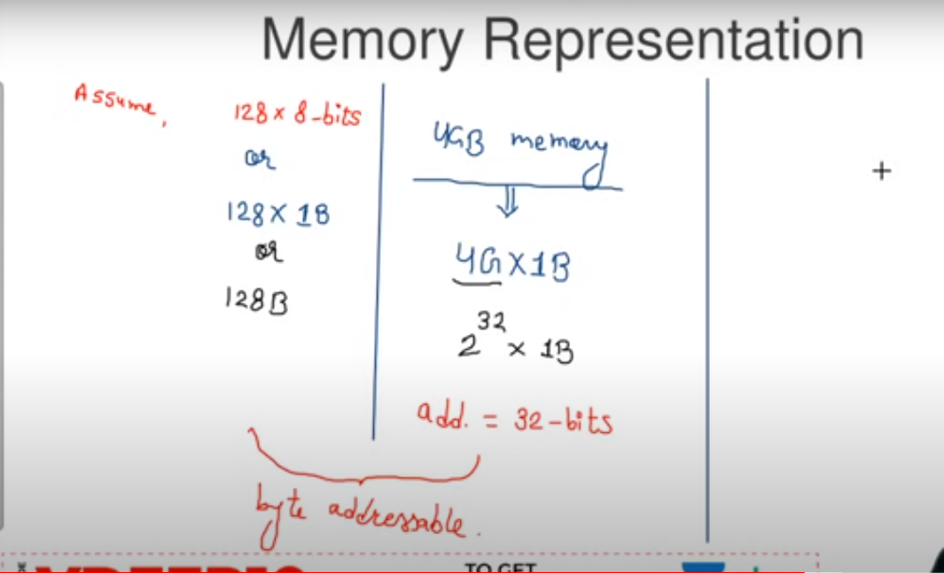

Slide 10
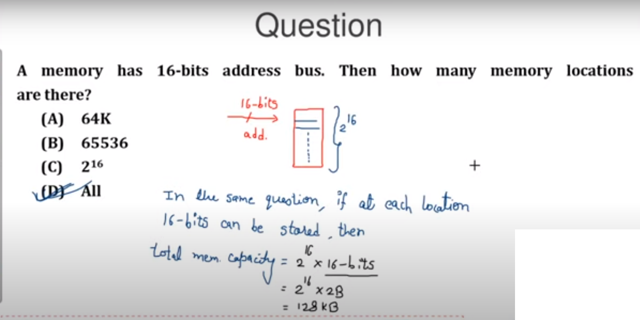

Slide 11
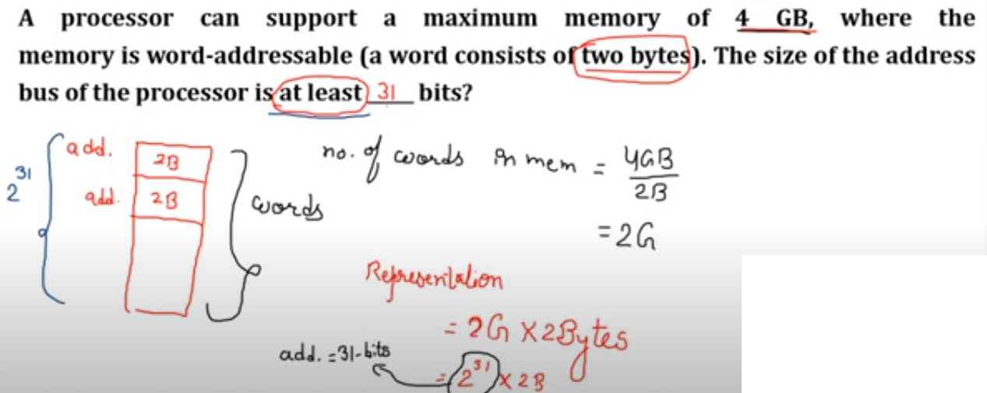

Slide 12
Key Characteristics of Computer Memory Systems
Table 4.1
Notes:
The complex subject of computer memory is made more manageable if we classify
memory systems according to their key characteristics. The most important of these
are listed in Table 4.1.

Slide 13
Characteristics of Memory Systems
Location
Refers to whether memory is internal and external to the computer
Internal memory is often equated with main memory
Processor requires its own local memory, in the form of registers
Cache is another form of internal memory
External memory consists of peripheral storage devices that are accessible to the processor via I/O controllers
Capacity
Memory is typically expressed in terms of bytes
Unit of transfer
For internal memory the unit of transfer is equal to the number of electrical lines into and out of the memory module
Notes:
The term location in Table 4.1 refers to whether memory is internal and external
to the computer. Internal memory is often equated with main memory. But there
are other forms of internal memory. The processor requires its own local memory, in
the form of registers (e.g., see Figure 2.3). Further, as we shall see, the control unit
portion of the processor may also require its own internal memory. We will defer
discussion of these latter two types of internal memory to later chapters. Cache is
another form of internal memory. External memory consists of peripheral storage
devices, such as disk and tape, that are accessible to the processor via I/O controllers.
An obvious characteristic of memory is its capacity. For internal memory, this is
typically expressed in terms of bytes (1 byte = 8 bits) or words. Common word lengths
are 8, 16, and 32 bits. External memory capacity is typically expressed in terms of bytes.
A related concept is the unit of transfer. For internal memory, the unit
of transfer is equal to the number of electrical lines into and out of the memory
module. This may be equal to the word length, but is often larger, such as 64, 128, or
256 bits. To clarify this point, consider three related concepts for internal memory:
• Word: The “natural” unit of organization of memory. The size of a word is typically
equal to the number of bits used to represent an integer and to the instruction
length. Unfortunately, there are many exceptions. For example, the CRAY
C90 (an older model CRAY supercomputer) has a 64-bit word length but uses
a 46-bit integer representation. The Intel x86 architecture has a wide variety of
instruction lengths, expressed as multiples of bytes, and a word size of 32 bits.
• Addressable units: In some systems, the addressable unit is the word. However,
many systems allow addressing at the byte level. In any case, the relationship
between the length in bits A of an address and the number N of addressable
units is 2^{A} = N.
• Unit of transfer: For main memory, this is the number of bits read out of or
written into memory at a time. The unit of transfer need not equal a word or
an addressable unit. For external memory, data are often transferred in much
larger units than a word, and these are referred to as blocks

Slide 14
Method of Accessing Units of Data
Sequential access
Memory is organized into units of data called records
Access must be made in a specific linear sequence
Access time is variable
Direct access
Involves a shared read-write mechanism
Individual blocks or records have a unique address based on physical location
Access time is variable
Random access
Each addressable location in memory has a unique, physically wired-in addressing mechanism
The time to access a given location is independent of the sequence of prior accesses and is constant
Any location can be selected at random and directly addressed and accessed
Main memory and some cache systems are random access
Associative
A word is retrieved based on a portion of its contents rather than its address
Each location has its own addressing mechanism and retrieval time is constant independent of location or prior access patterns
Cache memories may employ associative access
Notes:
Another distinction among memory types is the method of accessing units of
data. These include the following:
• Sequential access: Memory is organized into units of data, called records.
Access must be made in a specific linear sequence. Stored addressing information
is used to separate records and assist in the retrieval process. A shared
read–write mechanism is used, and this must be moved from its current location
to the desired location, passing and rejecting each intermediate record.
Thus, the time to access an arbitrary record is highly variable. Tape units, discussed
in Chapter 6, are sequential access.
Direct access: As with sequential access, direct access involves a shared
read–write mechanism. However, individual blocks or records have a unique
address based on physical location. Access is accomplished by direct access
to reach a general vicinity plus sequential searching, counting, or waiting to
reach the final location. Again, access time is variable. Disk units, discussed in
Chapter 6, are direct access.
• Random access: Each addressable location in memory has a unique, physically
wired-in addressing mechanism. The time to access a given location is independent
of the sequence of prior accesses and is constant. Thus, any location
can be selected at random and directly addressed and accessed. Main memory
and some cache systems are random access.
• Associative: This is a random access type of memory that enables one to make
a comparison of desired bit locations within a word for a specified match, and
to do this for all words simultaneously. Thus, a word is retrieved based on a
portion of its contents rather than its address. As with ordinary random-access
memory, each location has its own addressing mechanism, and retrieval time
is constant independent of location or prior access patterns. Cache memories
may employ associative access.

Slide 15
Capacity and Performance:
The two most important characteristics of memory
Three performance parameters are used:
Access time (latency)
For random-access memory it is the time it takes to perform a read or write operation
For non-random-access memory it is the time it takes to position the read-write mechanism at the desired location
Transfer rate
The rate at which data can be transferred into or out of a memory unit
For random-access memory it is equal to 1/(cycle time)
Memory cycle time
Access time plus any additional time required before second access can commence
Additional time may be required for transients to die out on signal lines or to regenerate data if they are read destructively
Concerned with the system bus, not the processor
Notes:
From a user’s point of view, the two most important characteristics of memory
are capacity and performance. Three performance parameters are used:
• Access time (latency): For random-access memory, this is the time it takes to
perform a read or write operation, that is, the time from the instant that an
address is presented to the memory to the instant that data have been stored
or made available for use. For non-random-access memory, access time is the
time it takes to position the read–write mechanism at the desired location.
• Memory cycle time: This concept is primarily applied to random-access memory
and consists of the access time plus any additional time required before a second
access can commence. This additional time may be required for transients to die
out on signal lines or to regenerate data if they are read destructively. Note that
memory cycle time is concerned with the system bus, not the processor.
• Transfer rate: This is the rate at which data can be transferred into or out of a
memory unit. For random-access memory, it is equal to 1/(cycle time).

Slide 16
Locality Of Reference
If memory location X is accessed at time t,
(assuming no branch instructions)
there is a high probability that
memory location X + 1 will also be accessed in the near future.
This clustering of memory references into groups is an example of
Locality of Reference

Slide 17
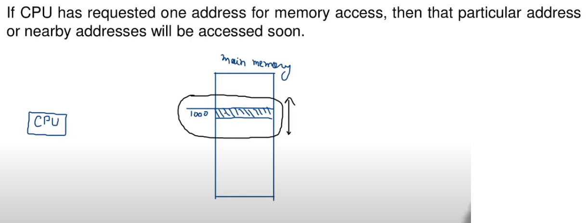
Locality of References
Locality = Neighborhood
Reference = Reference of CPU to Memory (RAM)
To improve the performance of the system we use locality of reference.

Slide 18
Locality Of Reference – Types
Temporal locality
Recently accessed items tend to be accessed again in the near future.
Spatial locality
Accesses tend to be clustered in the address space
(for example, as in arrays or loops).
Sequential locality
Instructions tend to be accessed sequentially.

Slide 19
Locality Of Reference – Benefit
a small amount of very fast memory can be used to effectively accelerate the majority of memory accesses.
REASON:
only a small amount of the entire memory space is being accessed at any given time
values in that space are being accessed repeatedly.
∴values from a slower memory can be copied to a smaller but faster memory that resides higher in the hierarchy.

Slide 20
Locality Of Reference – Benefit
REASON:
only a small amount of the entire memory space is being accessed at any given time
values in that space are being accessed repeatedly.
∴values from a slower memory can be copied to a smaller but faster memory that resides higher in the hierarchy.
Results in a memory system that can store
A large amount of information in a large, low cost memory
yet provide nearly the same access speeds that would result from using very fast but expensive memory.

Slide 21
Cache Memory
Cache Memory is
a relatively small, fast memory
Interposed between a larger, slower memory and
the logic that accesses the larger memory.
holds recently accessed data
designed to speed up subsequent access to the same data.
combines memory access time of
expensive, high-speed memory with
the large memory size of
less expensive, lower-speed memory.

Slide 22
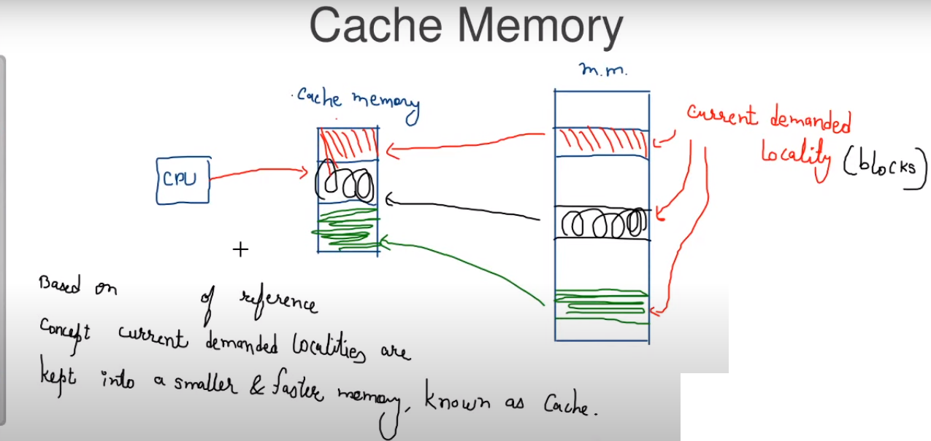

Slide 23
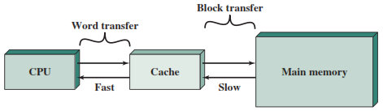
Cache Memory

Slide 24
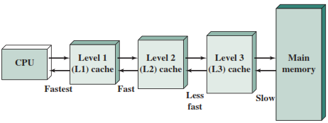
Cache Memory – Organization

Slide 25
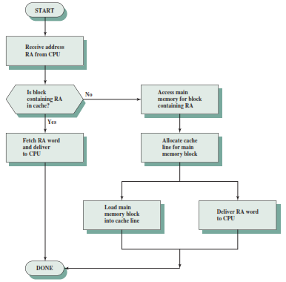
Cache Memory – Read Operation

Slide 26
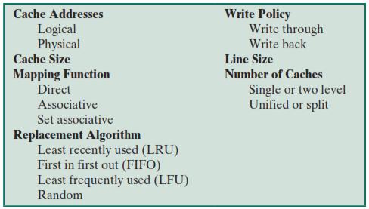
Elements Of Cache Design

Slide 27
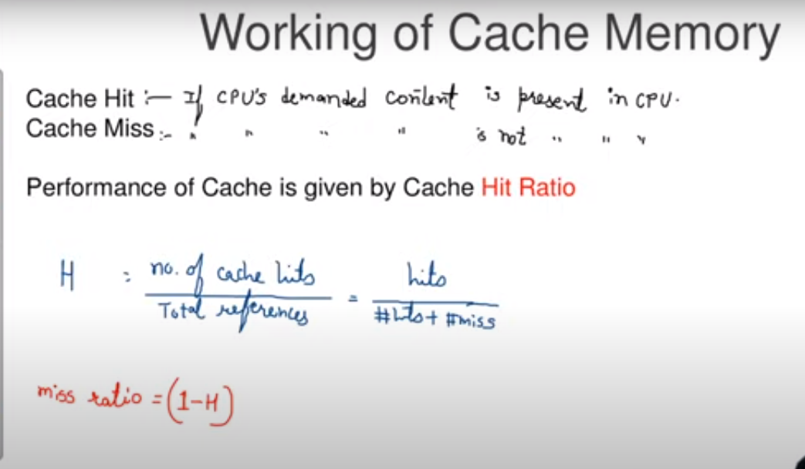

Slide 28
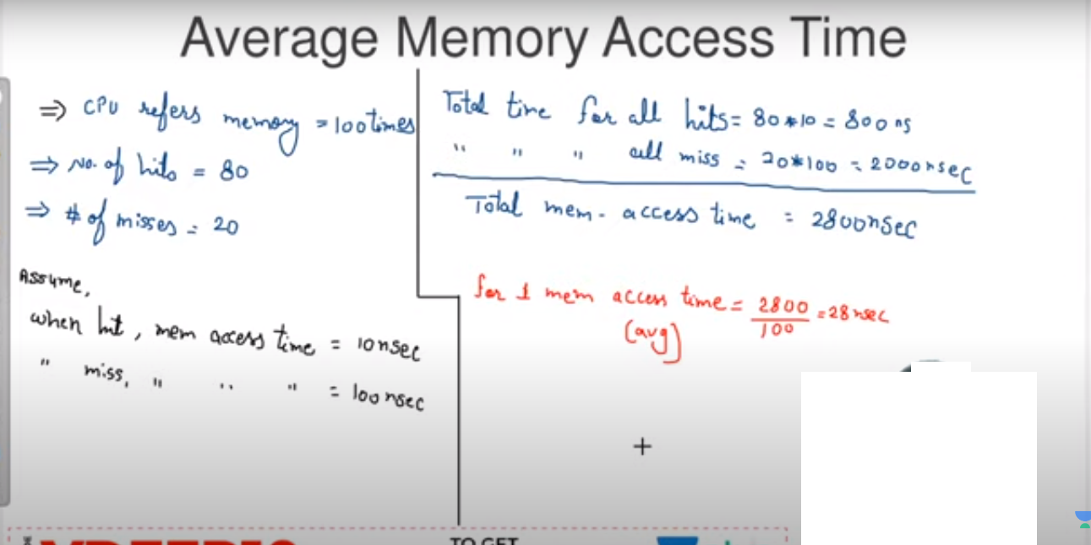

Slide 29
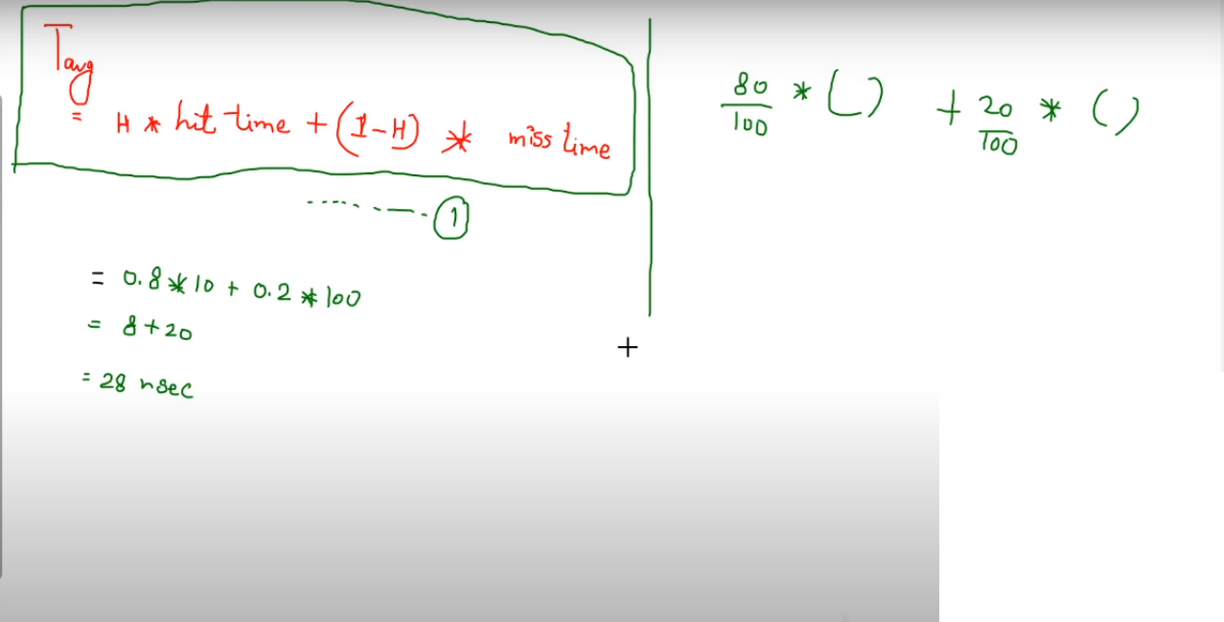

Slide 30
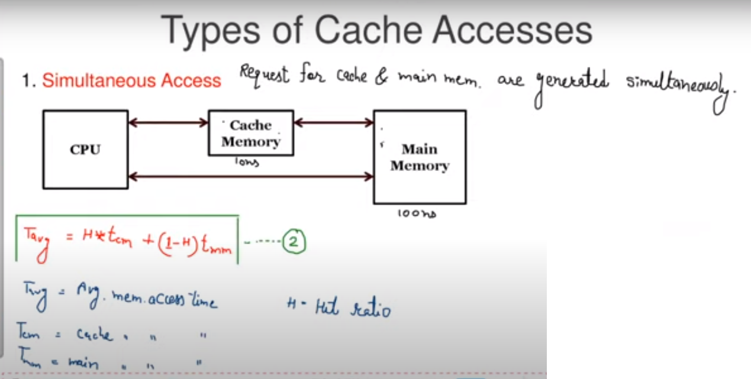

Slide 31
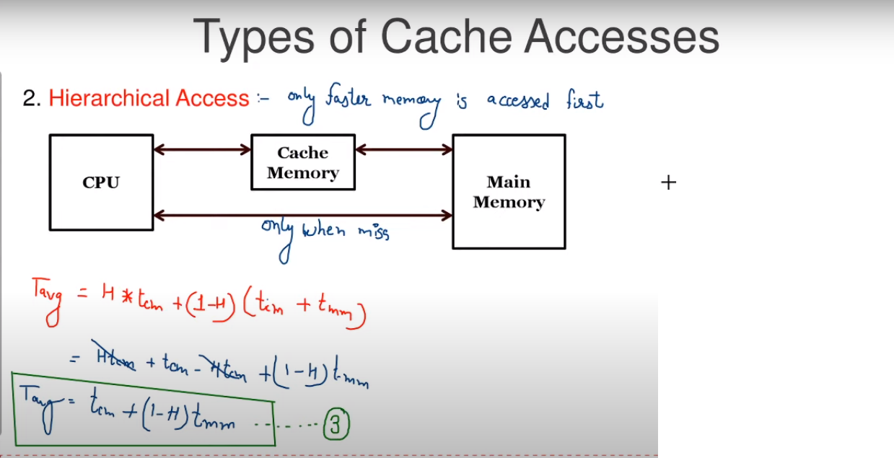

Slide 32
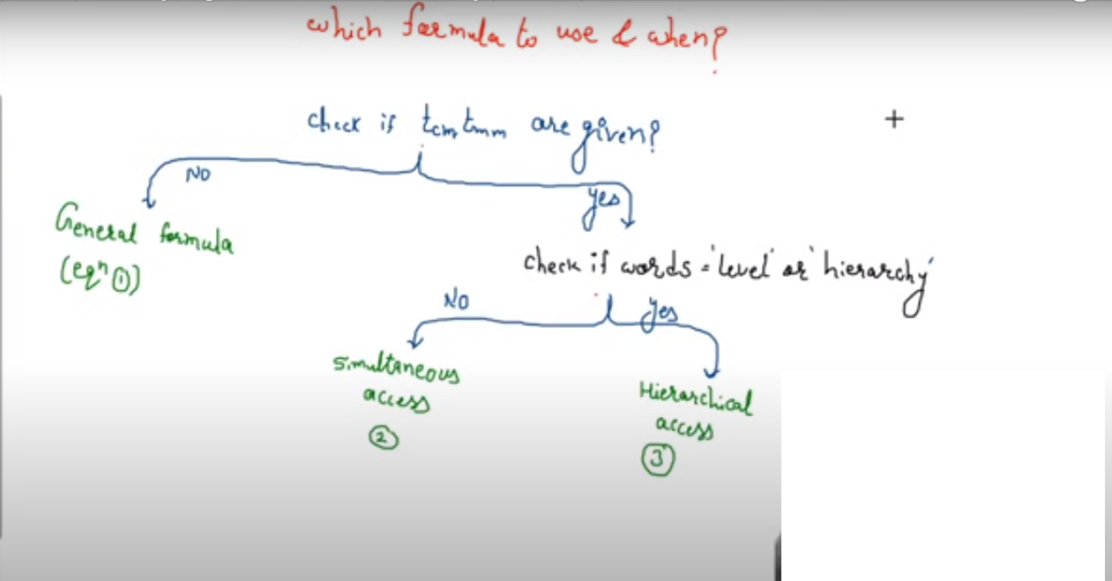

Slide 33
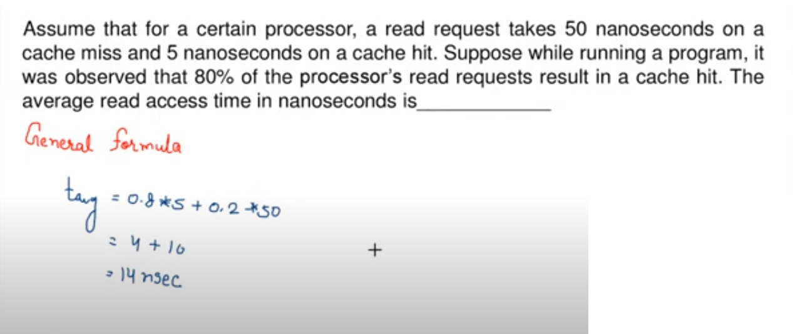
Example

Slide 34
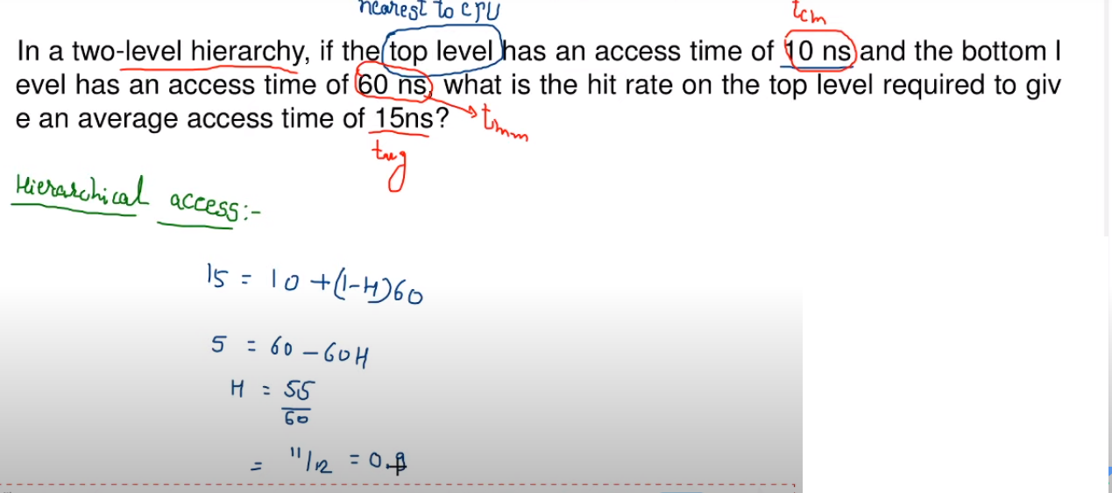
Example 2

Slide 35
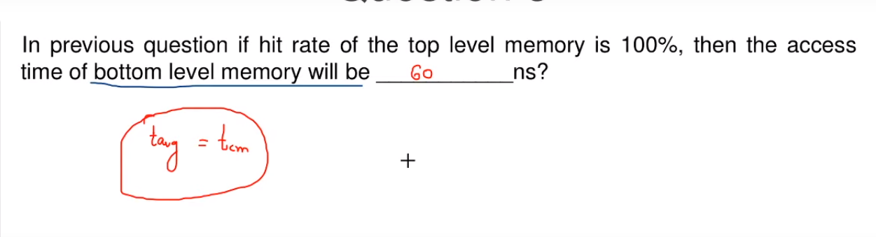

Slide 36
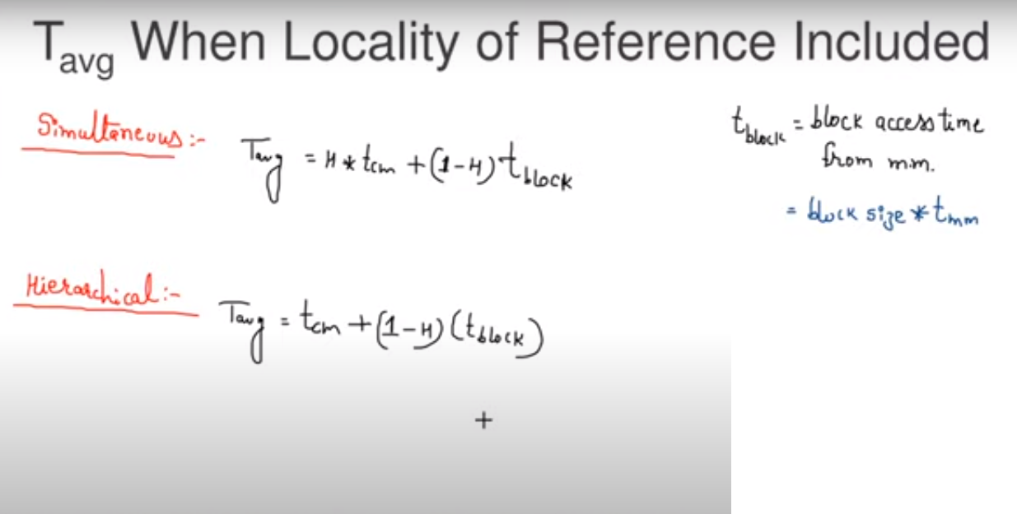

Slide 37
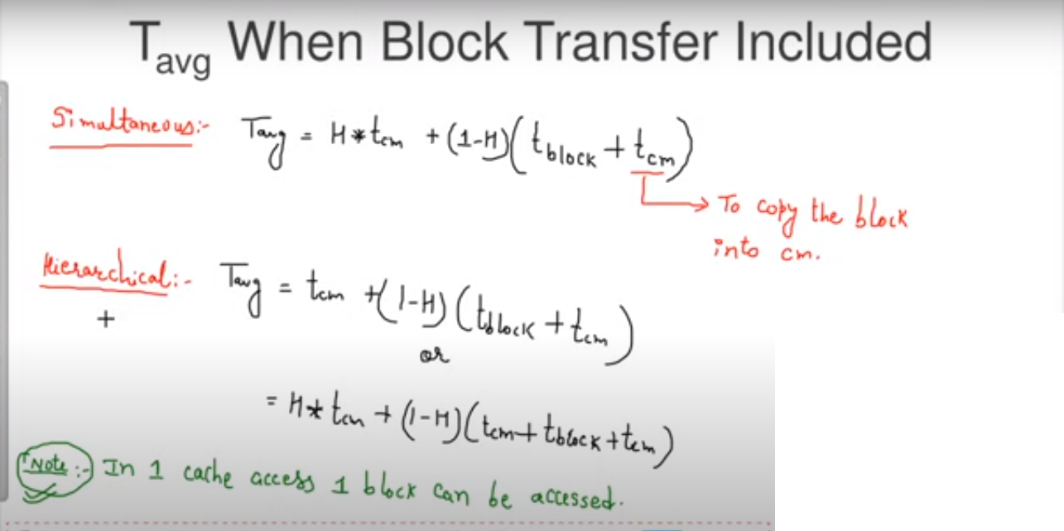

Slide 38
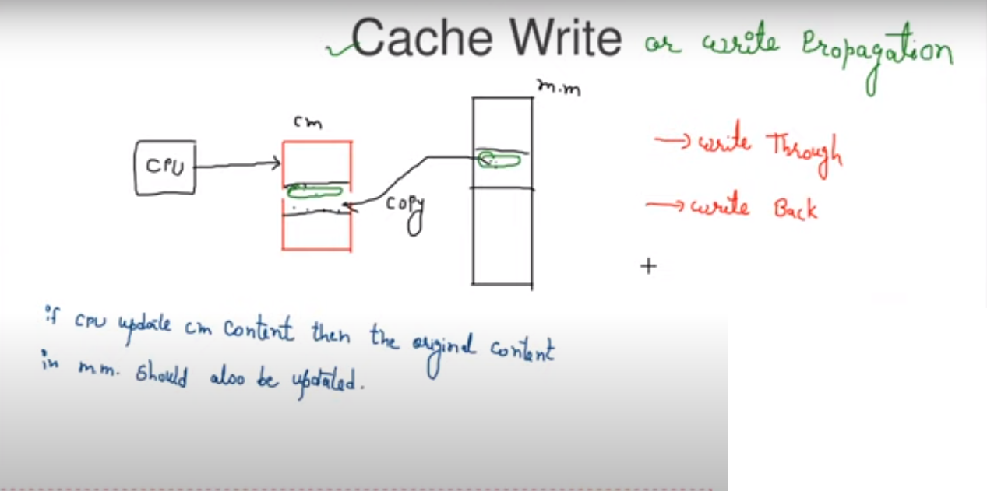

Slide 39
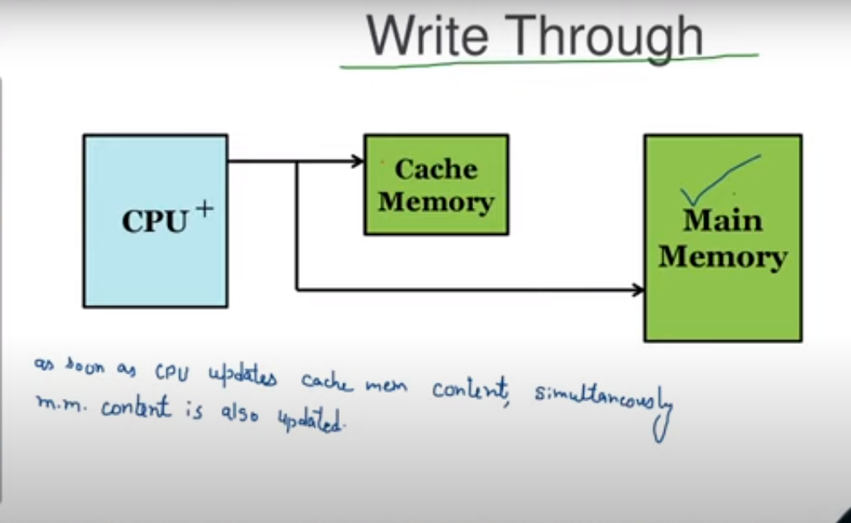

Slide 40
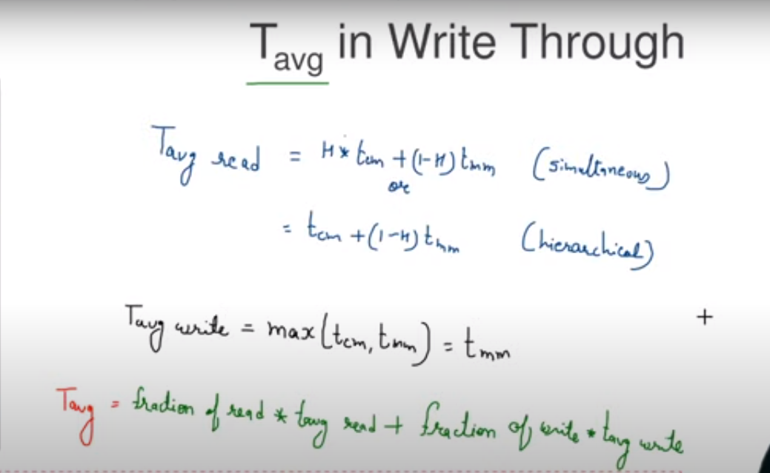

Slide 41
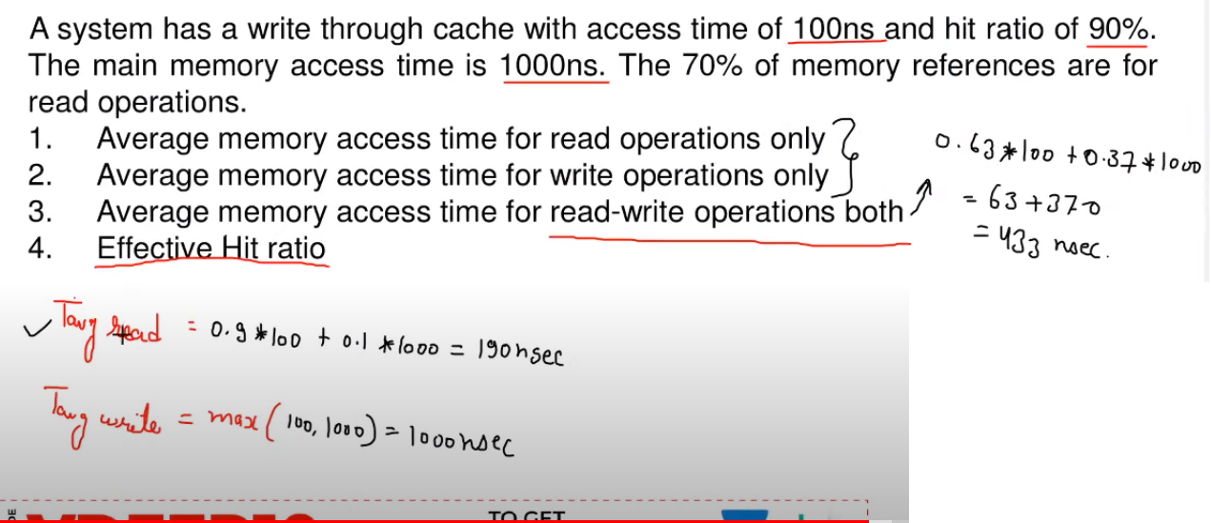
Example-3

Slide 42
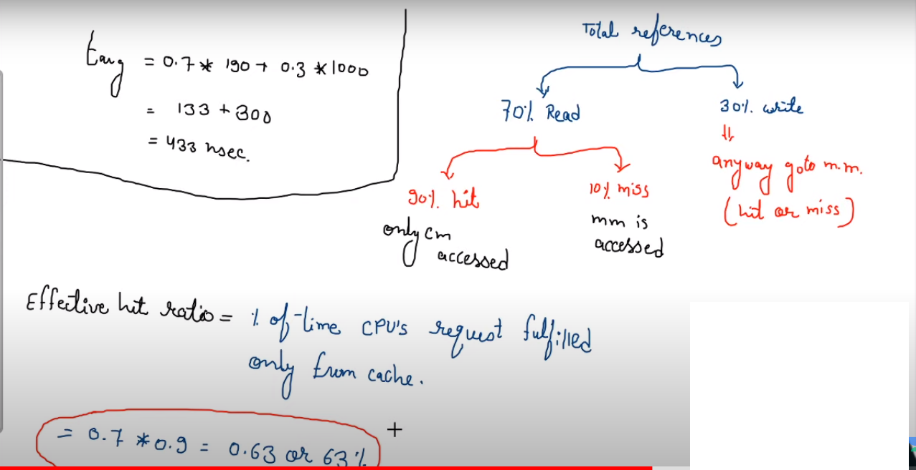

Slide 43
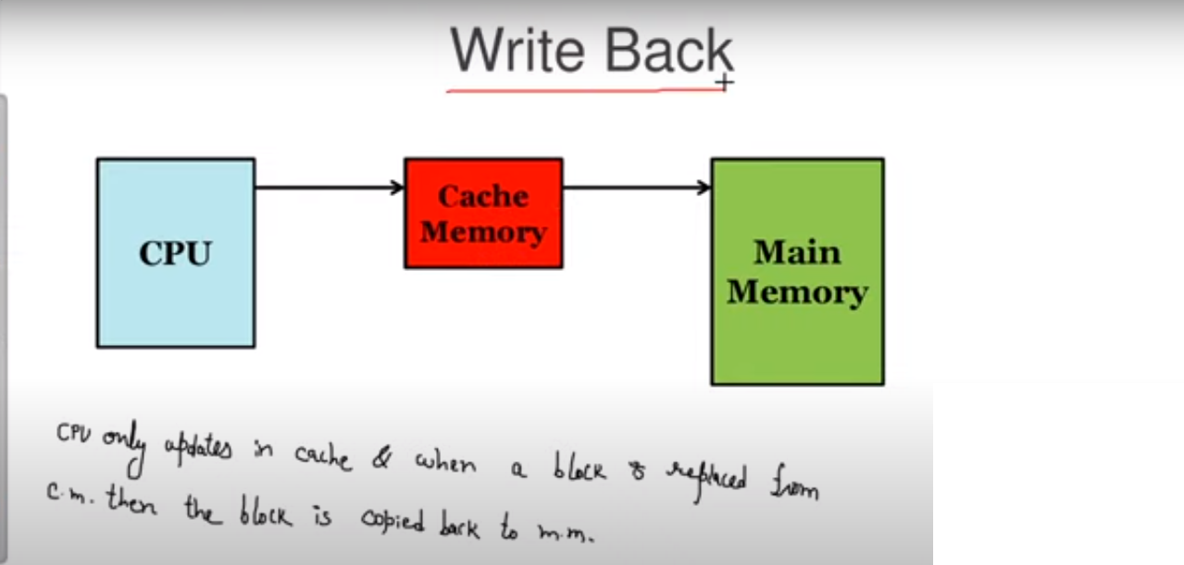

Slide 44
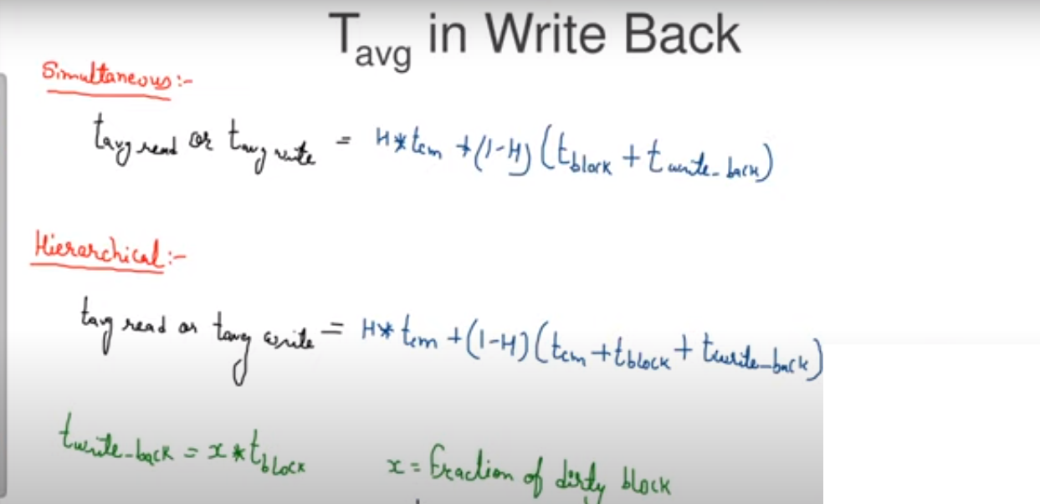

Slide 45
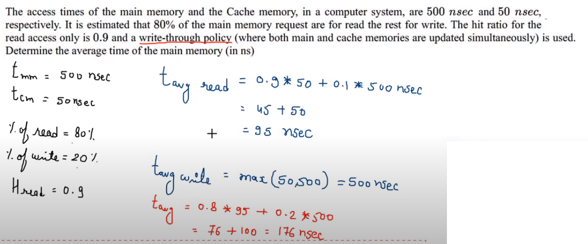
Example-4

